Slide 1
Formula1, Spark, Data Ingestion csv
Submitted By
Maimoona Khilji

Slide 2
Content
Formula1 Project Overview
Overview of Formula1, data, data to data lake, requirement, architecture Drivers File
Spark Introduction
Spark Cluster Architecture, Dataframe and Datasource API Overview
Data Ingestion - CSV
Overview, Requirements and Detailed practical implementation of Circuits File and Races File.

Slide 3
Formula1 Project Overview

Slide 4
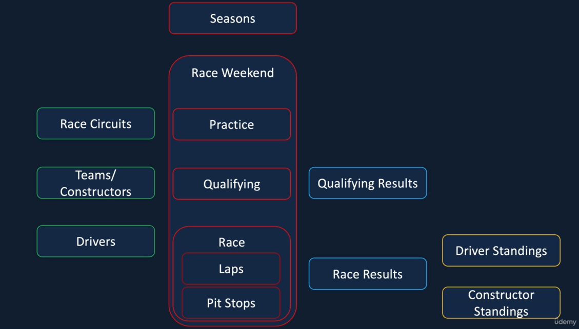
Formula 1 Overview

Slide 5
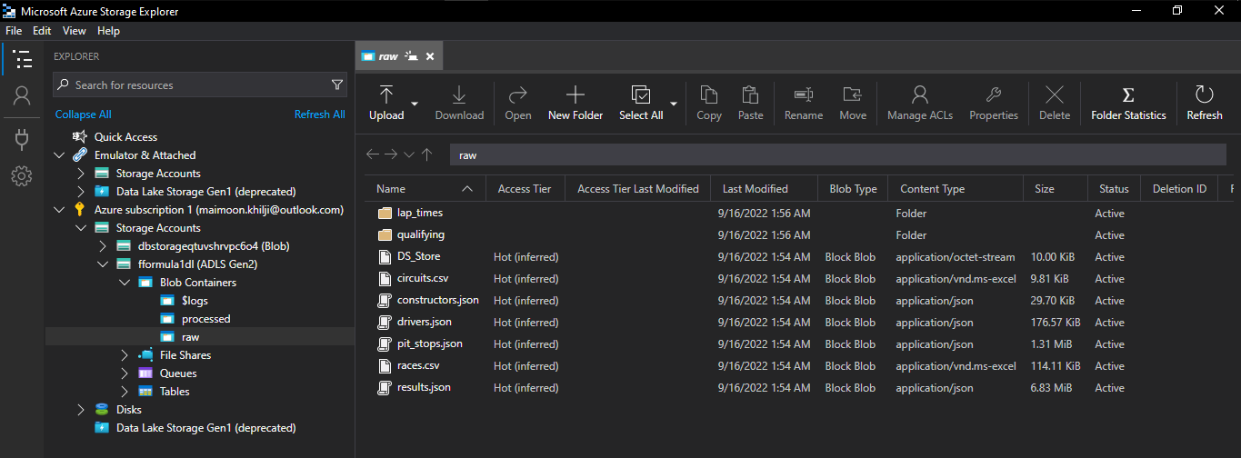
Data to Data lake

Slide 6
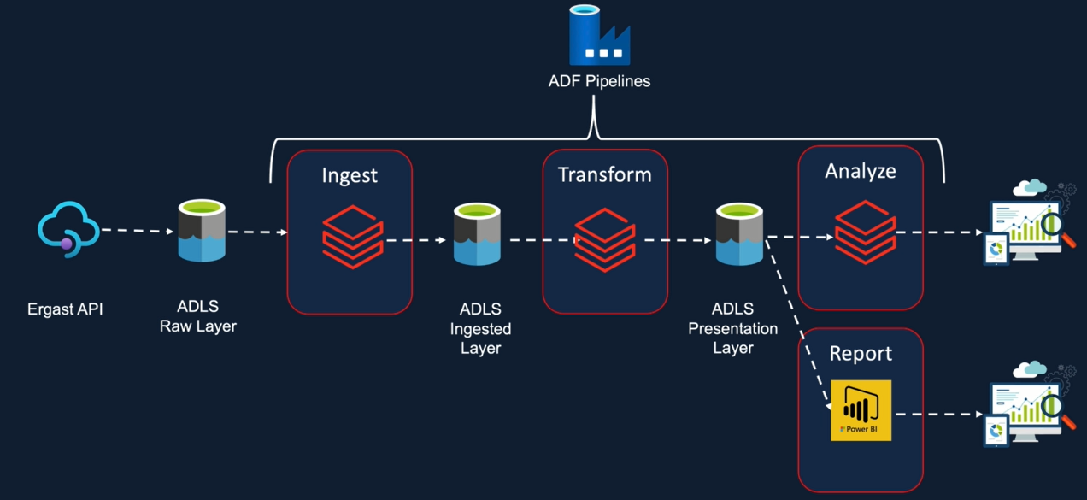
Solution Architecture

Slide 7
Spark Introduction

Slide 8
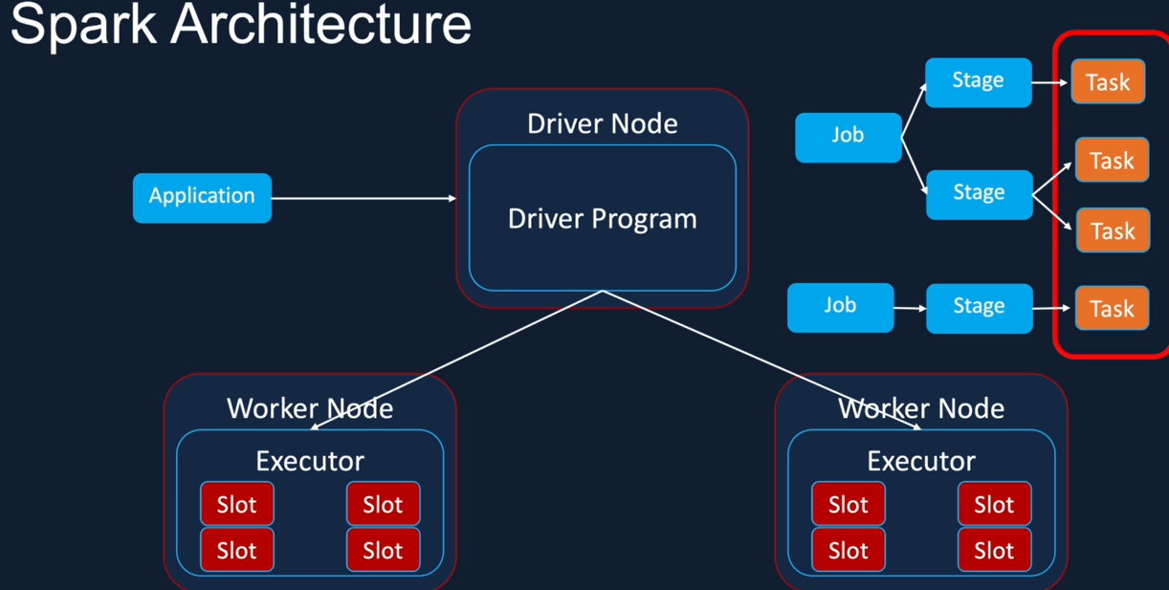
Spark Architecture

Slide 9
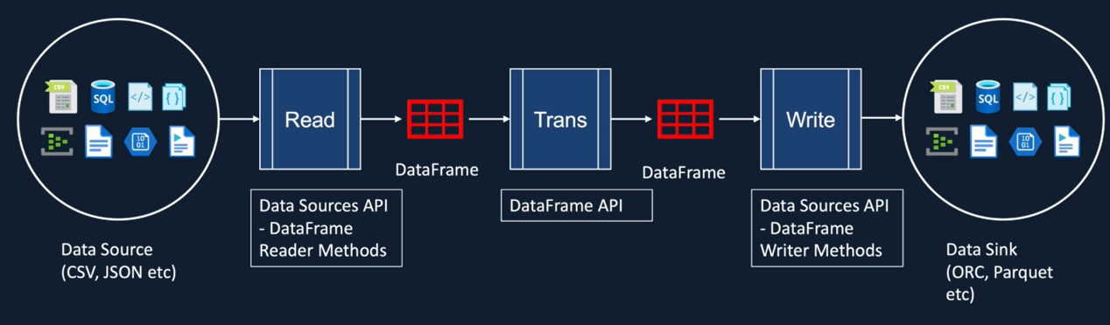
Spark DataFrame

Slide 10
Data Ingestion - CSV

Slide 11
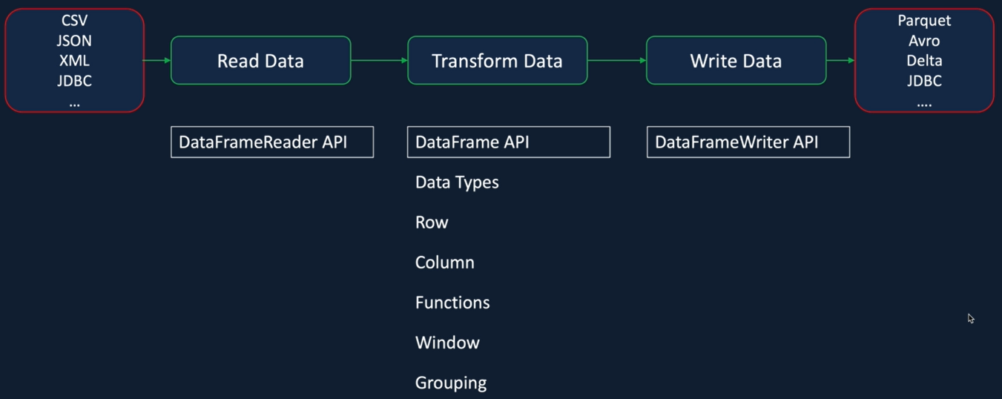
Data Ingestion Overview

Slide 12
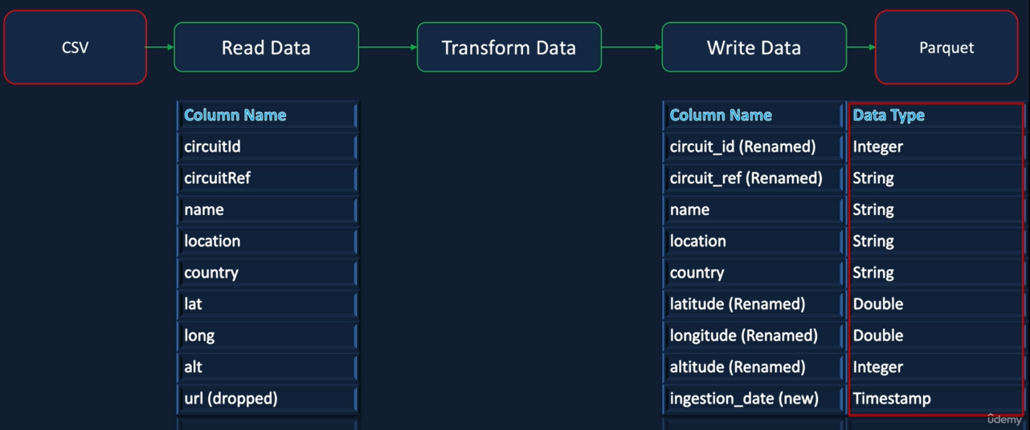
Data Ingestion – Circuits.csv File

Slide 13
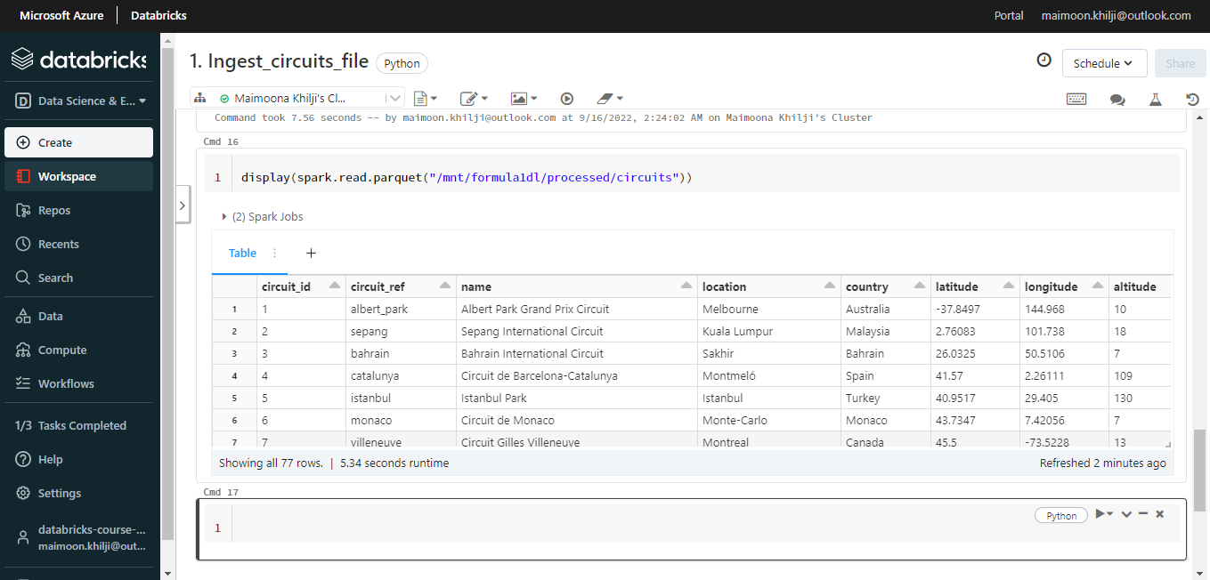
Ingest Circuits.csv File

Slide 14
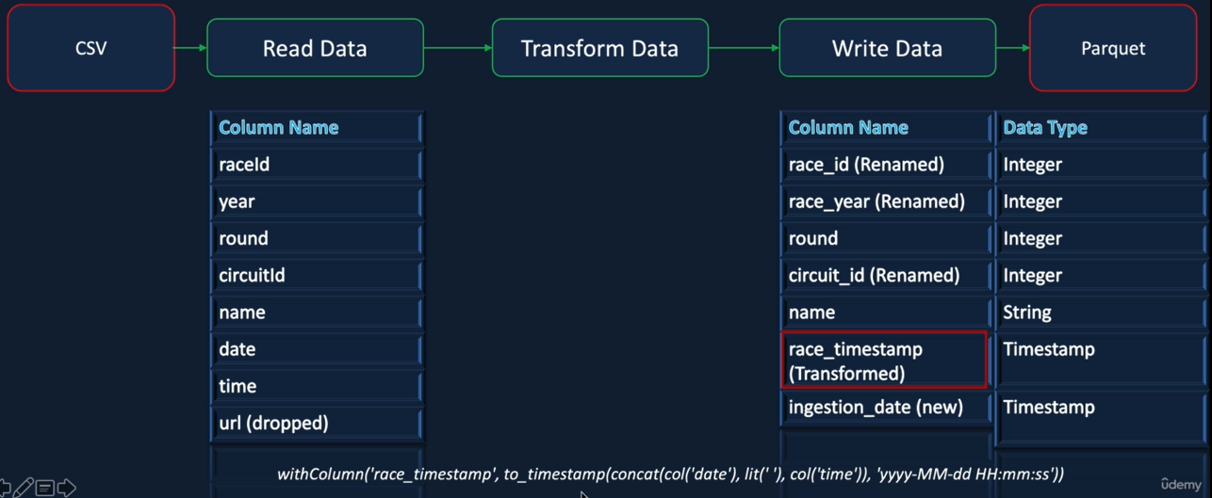
Data Ingestion – Races.csv File

Slide 15
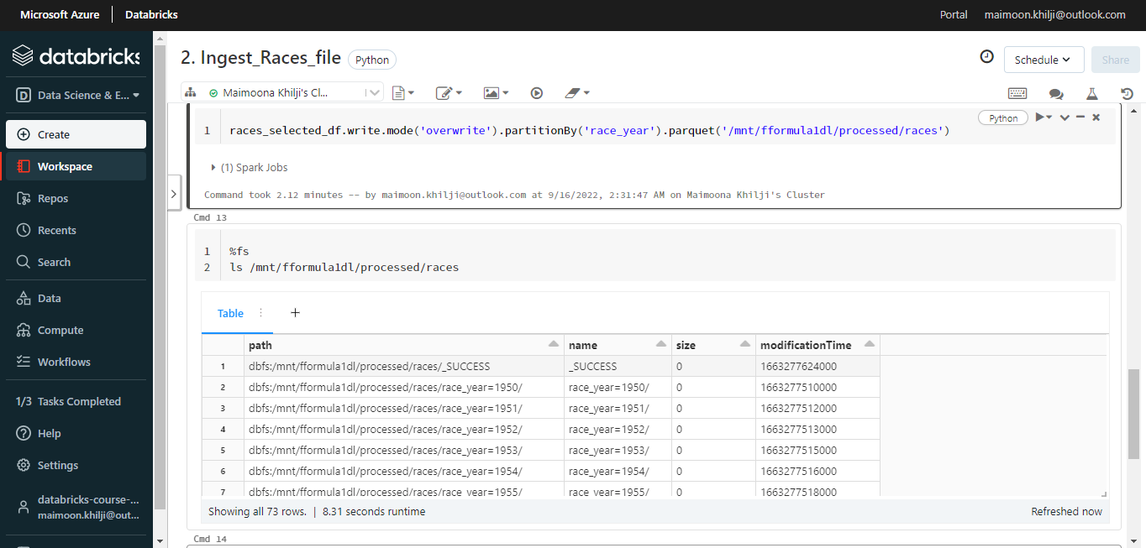
Ingest Races.csv File

Slide 16
THE END

